Slide 1
Vancouver Public Library
World Languages
Web scrapping Project
Rochita Sundar
Feb’22

Slide 2
Introduction
Public Library System for the city of Vancouver, British Columbia
Third largest public library system in all of Canada
Over 20 branches, 1 central library location & online
Over 9.5 million materials: books, e-books, CDs, DVDs, magazines etc.
Serving >400,000 active members
Objective
Scrape the website of VPL using automation test software
Study international language collection carried by each VPL location
Gather information on language collections, titles, authors, categories, availability statuses & user ratings to draw insights
Motivation
General curiosity in reading, languages & interest in exploring resources in my locality
Reference: https://en.wikipedia.org/wiki/Vancouver_Public_Library

Slide 3
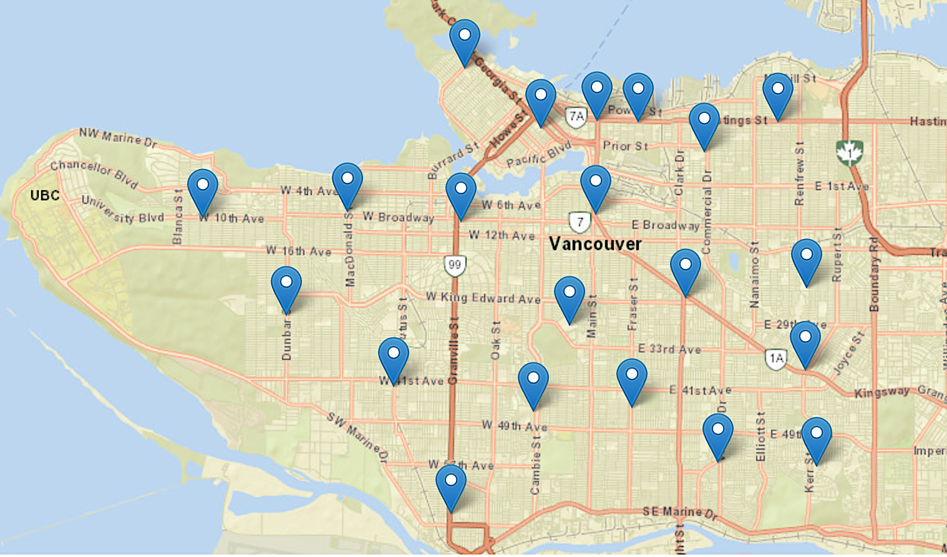
Library location vs. language collection analysis gives an insight to international demographic residing in different parts of Vancouver
nə́c̓aʔmat ct Strathcona Branch
Chinese, French
& Spanish
Carnegie Branch
Chinese
Joe Fortes Branch
Chinese, French, German,
Persian & Spanish
Britannia Branch
Chinese, French &
Spanish
All locations carry material in Chinese
All but one, carry material in French
7 locations carry Spanish, 4 locations carry Vietnamese & 3 locations carry Tagalog materials
Central library carries all international language materials
Hastings Branch
Chinese, French
& Italian
Central Library
Kitsilano Branch
Chinese & French
Firehall Branch
Chinese & French
Mount Pleasant Branch
Chinese, French,
Spanish & Vietnamese
West Point Grey Branch
Chinese & French
Renfrew Branch
Chinese, French & Vietnamese
Terry Salmon Branch
Chinese, French, Spanish
& Tagalog
Kensington Branch
Chinese, French, Spanish,
Tagalog & Vietnamese
Dunbar Branch
Chinese & French
South Hill Branch
Chinese, French,
Hindi & Punjabi
Collingwood Branch
Chinese & French
Kerrisdale Branch
Chinese & French
Oakridge Branch
Chinese & French
Fraserview Branch
Chinese & French
Champlain Heights Branch
Chinese & French
Marpole Branch
Chinese & French
Reference: https://www.vpl.ca/hours-locations

Slide 4
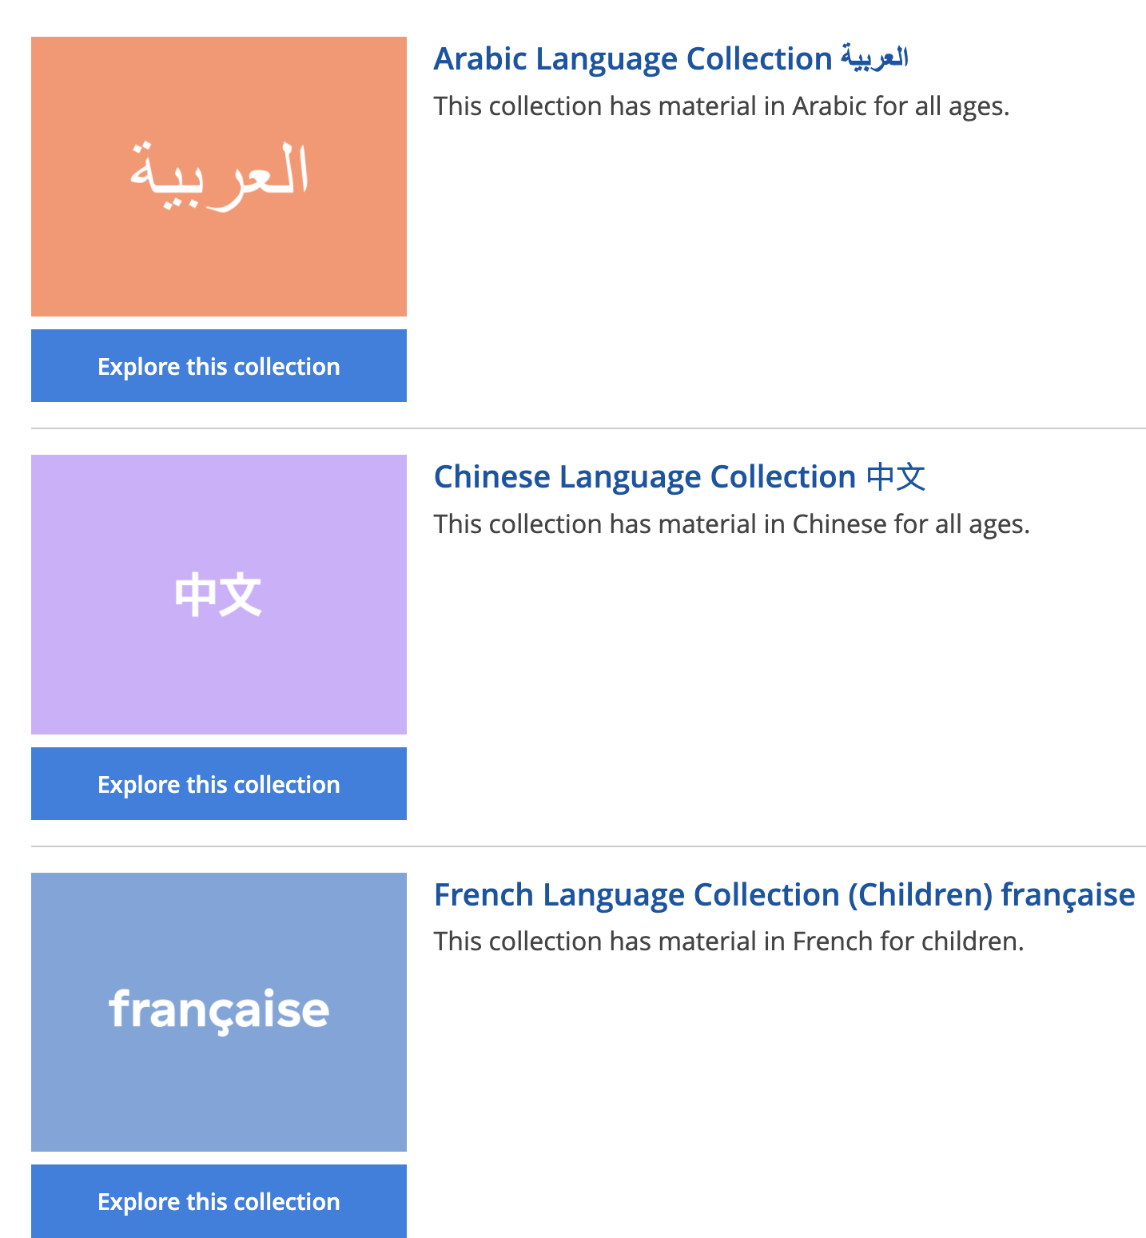
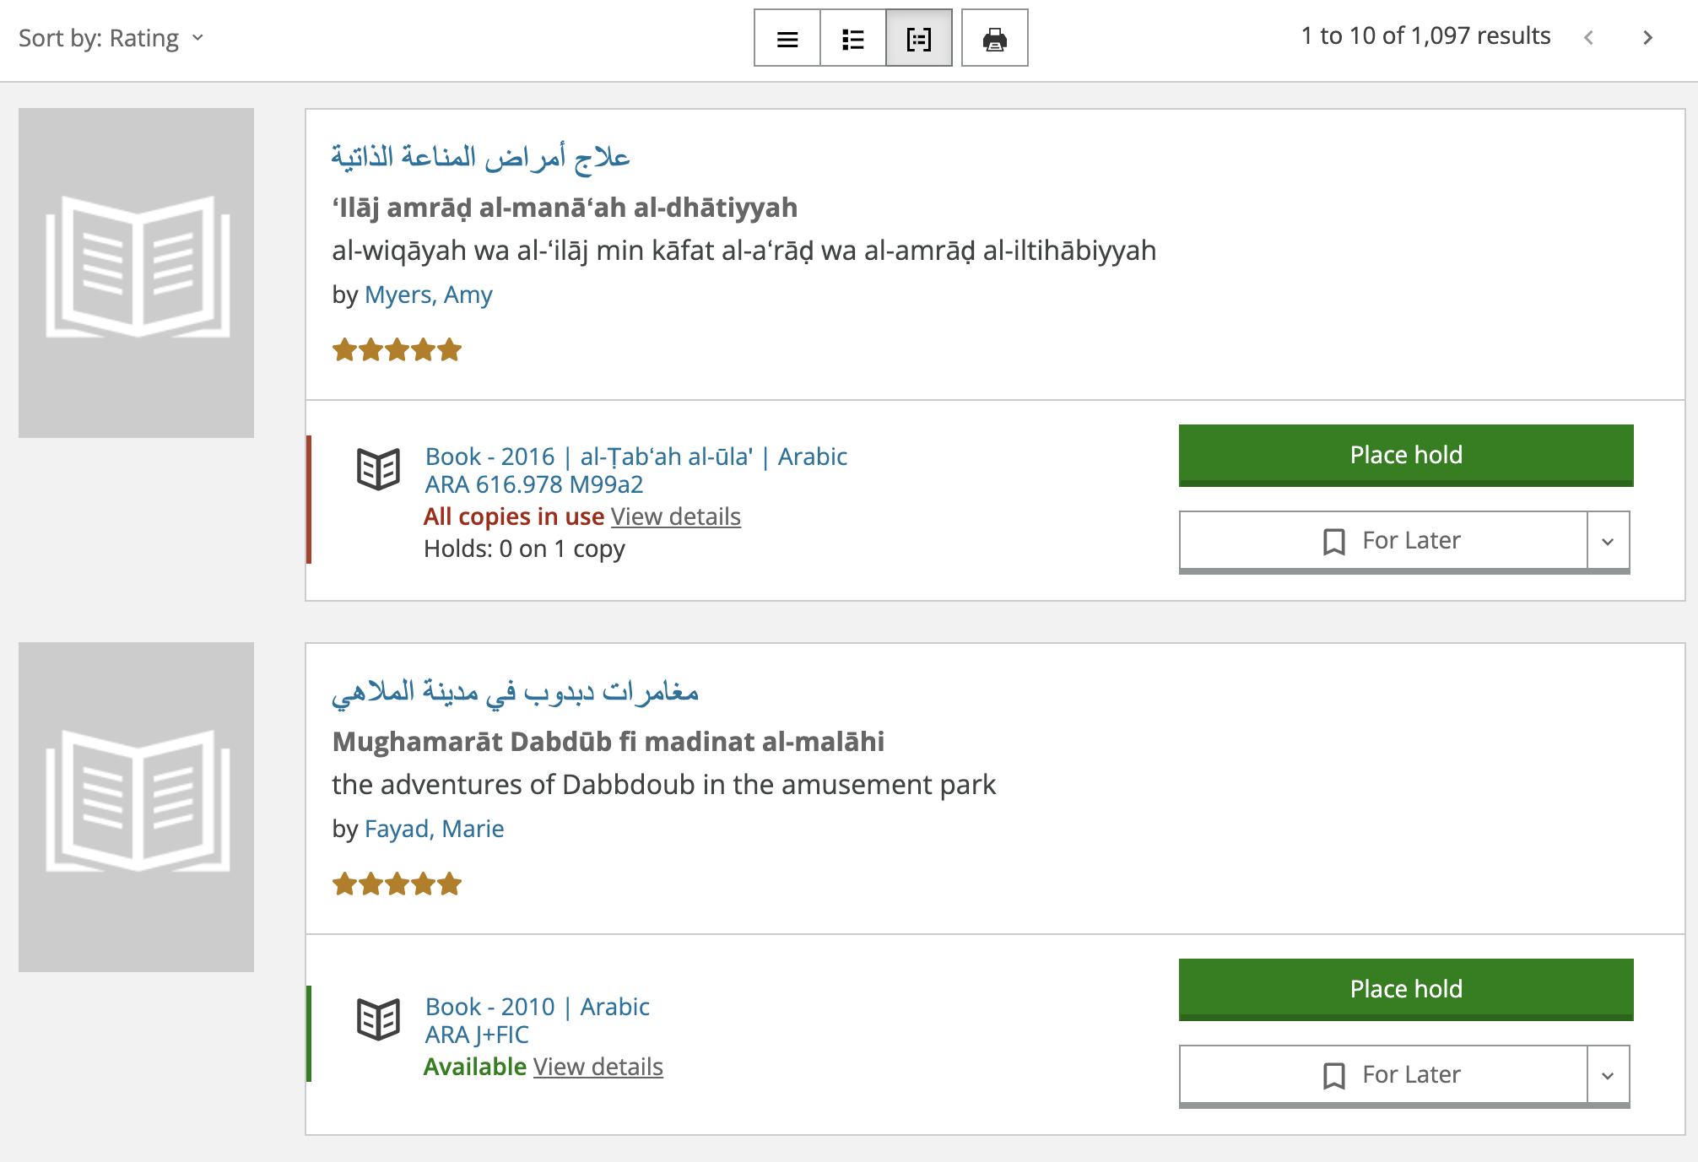
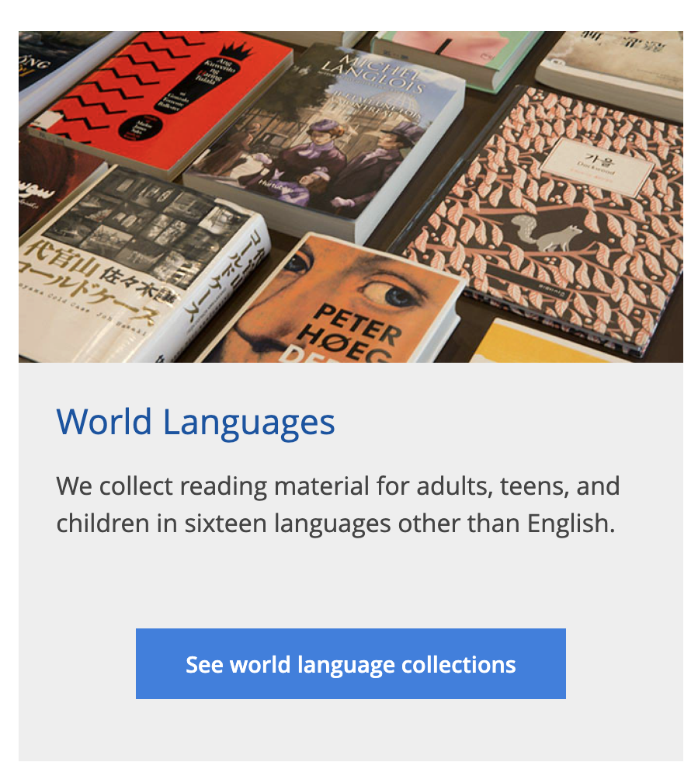

language
title
multiple pages
author & rating
category & availability
multiple records
Per page
16 international
languages
VPL Website & data collection:
Crawler scrapped more than 70K+ records (information on language, title, author, rating, category & availability)
Reference: https://www.vpl.ca/borrowing/world-languages

Slide 5
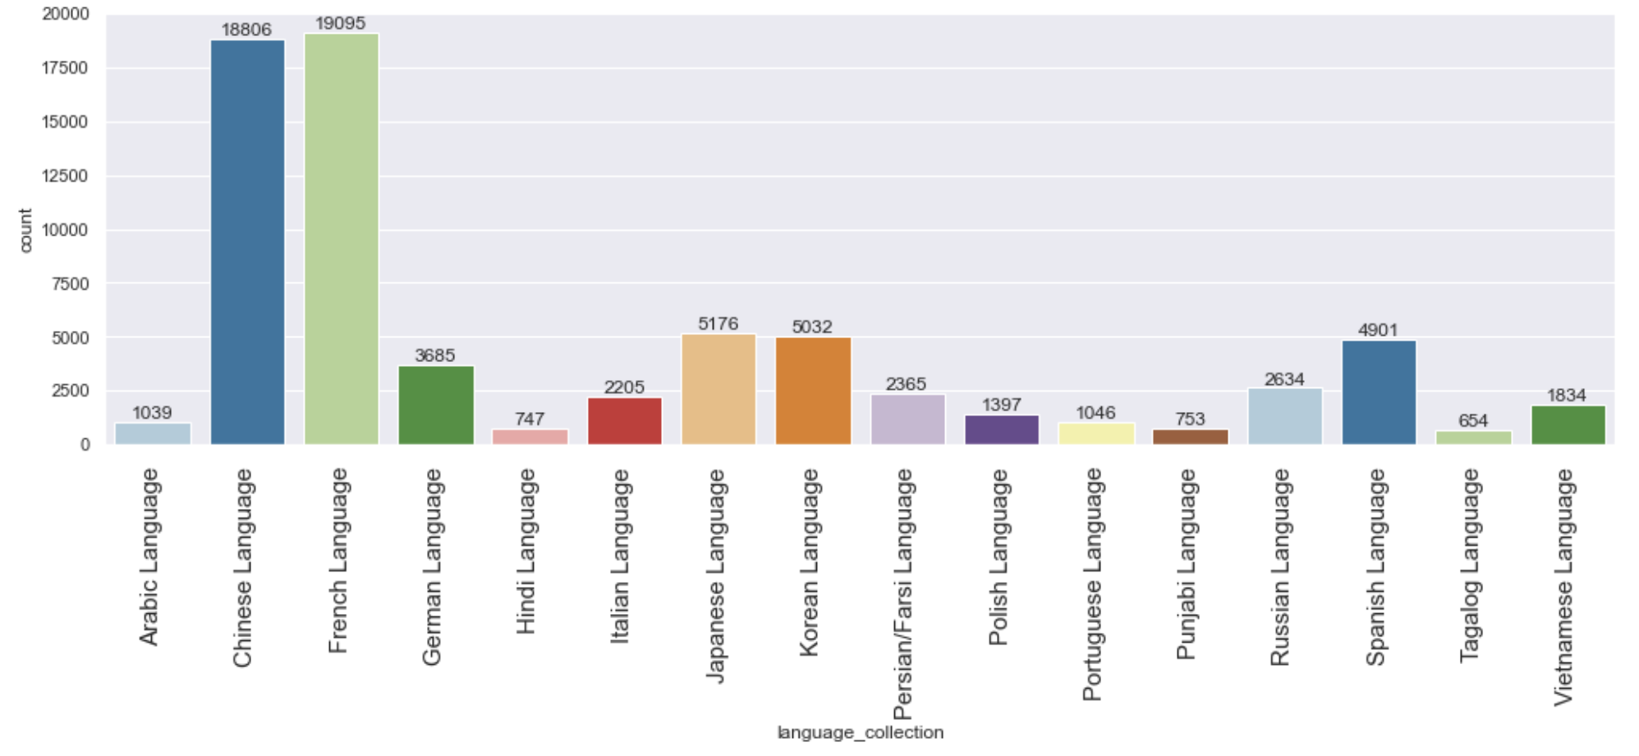
Language Collection : Count of materials across VPL locations
Maximum material is available in French & Chinese languages followed by Japanese & Korean languages
Tagalog, Hindi & Punjabi languages have some of the lowest number of material available
Let’s explore top authors…..

Slide 6
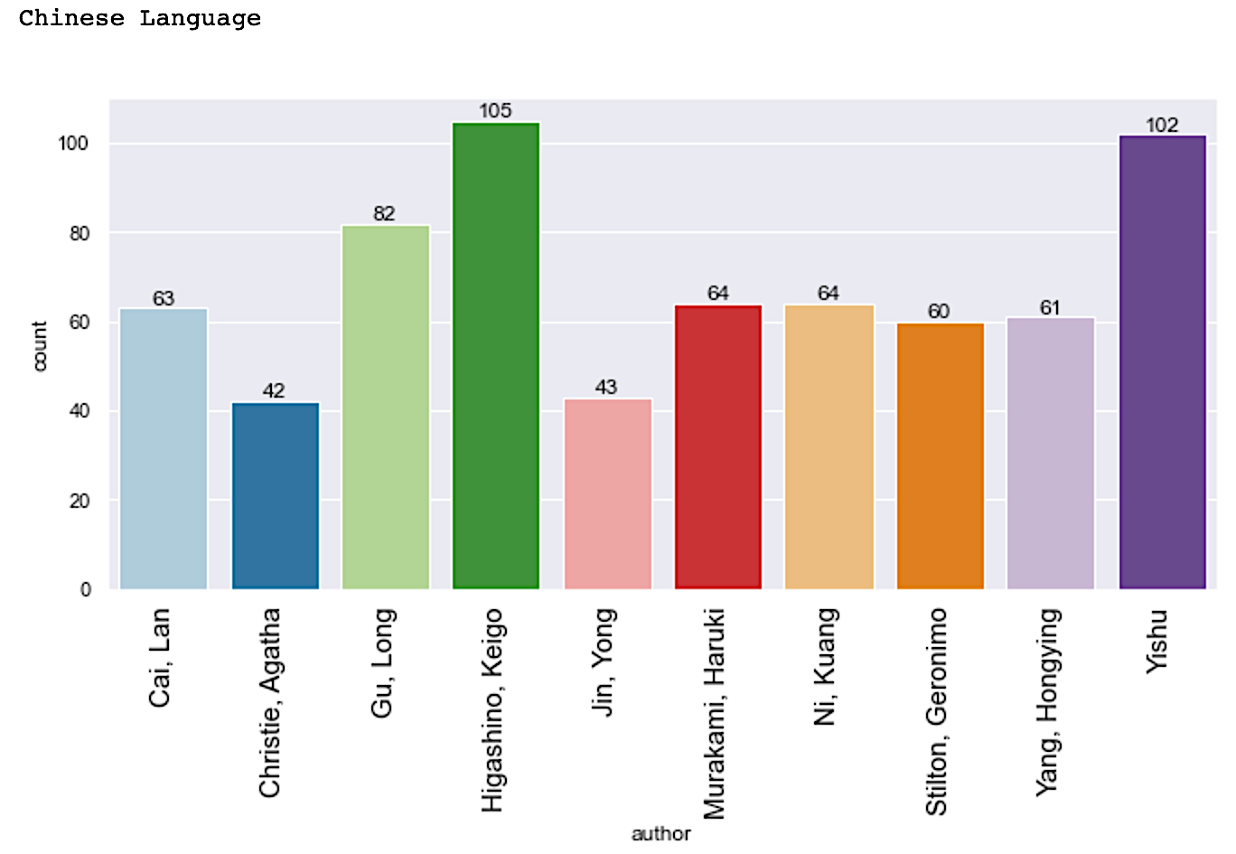
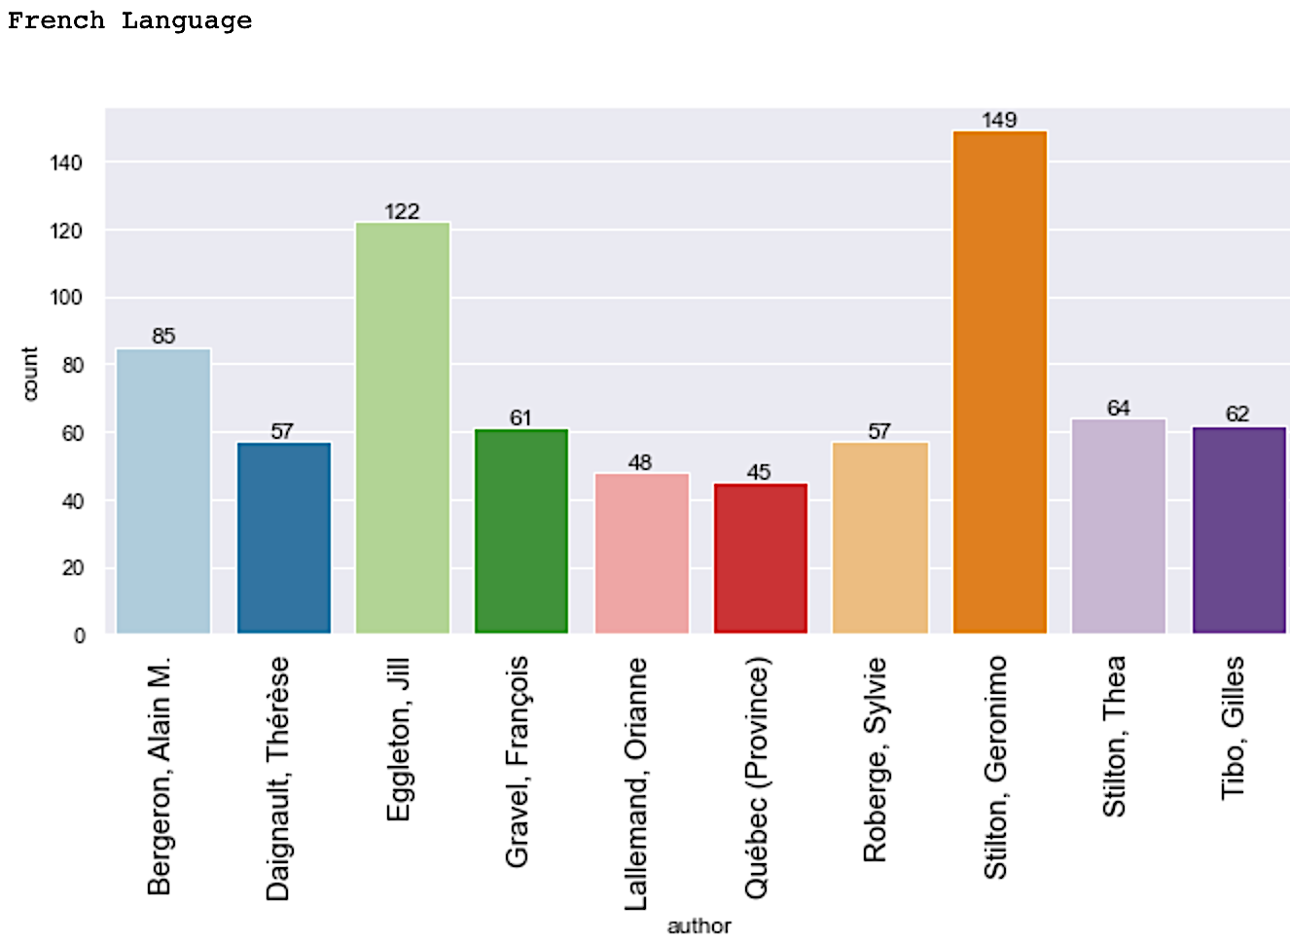
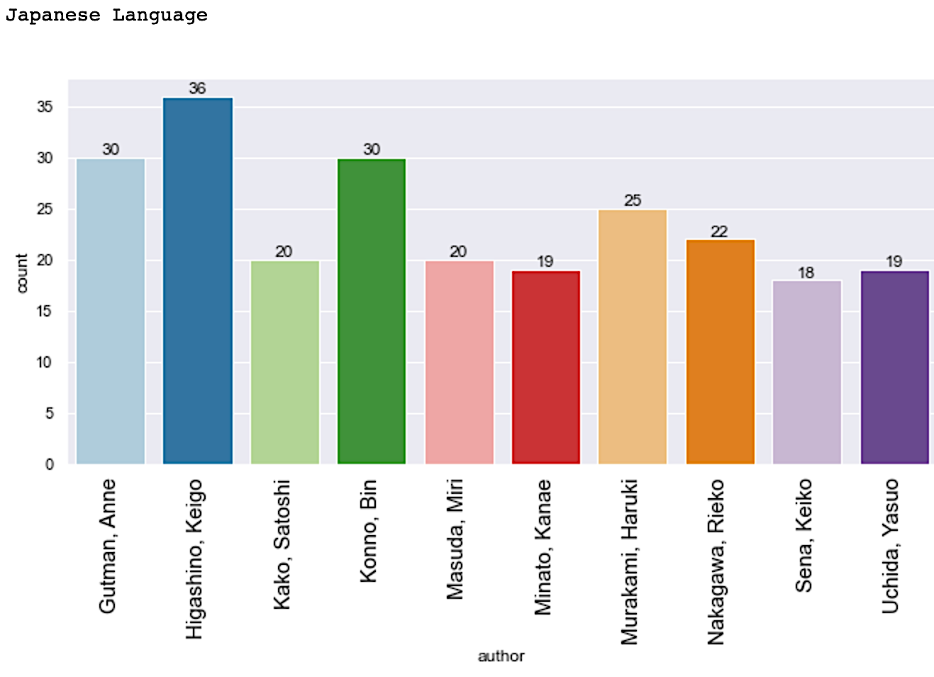
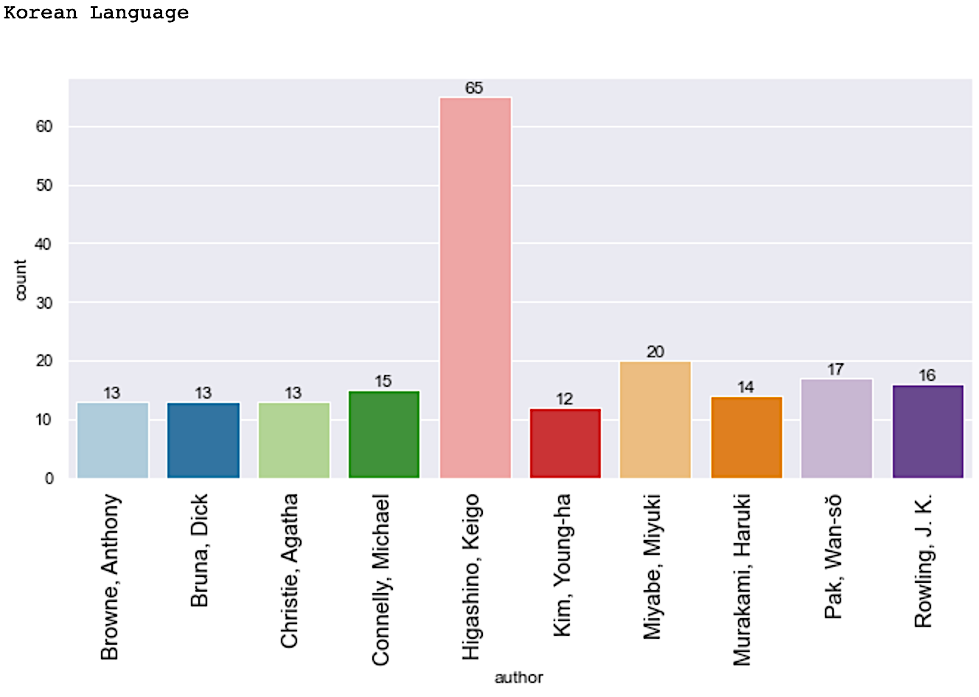
Top 10 authors by number of published materials at VPL for international languages
Interestingly, 'Higashino , Keigo' makes an appearance (# 1) under all Chinese, Japanese & Korean languages for max. materials at VPL
Stilton, Geronimo' & 'Eggleton , Jill' are top French artists with 140+ & 120+ materials available at VPL locations respectively
Let’s explore Kiego’s work’s popularity …..

Slide 7
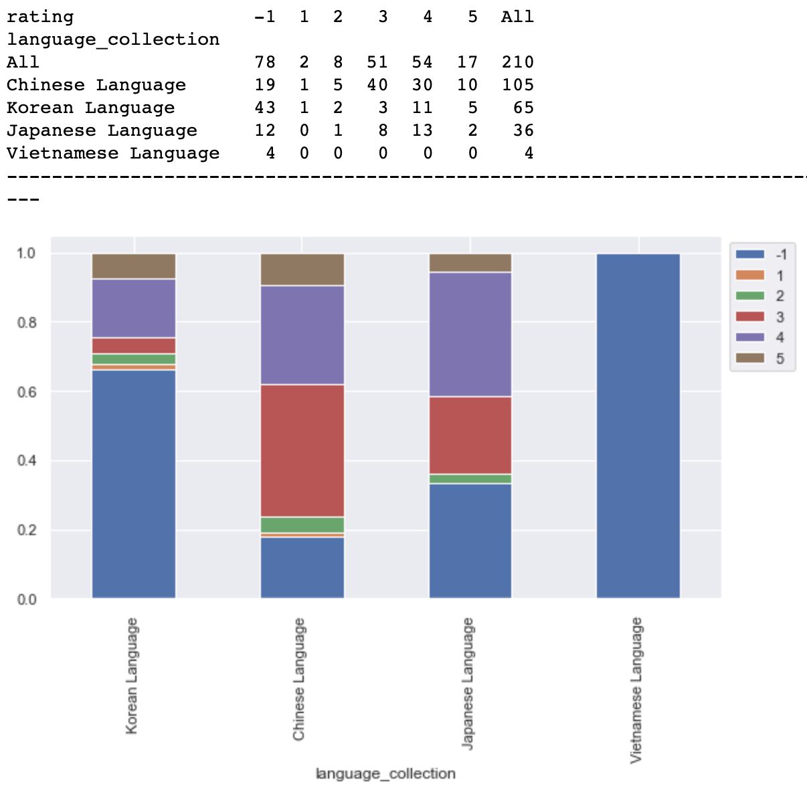
Popularity (rating) of Higashino, Keigo’s materials by languages
"-1" rating corresponds to "no rating information available". No rating information is available for any of his 4 materials in Vietnamese language. ~60% of his work in Korean language, ~20% of his work in Chinese language & ~30% of his work in Japanese language is not rated
~40% of his work in Chinese language has a rating of 3 stars, ~25% has a rating of 4 stars and ~5% a rating of 5 stars

Slide 8
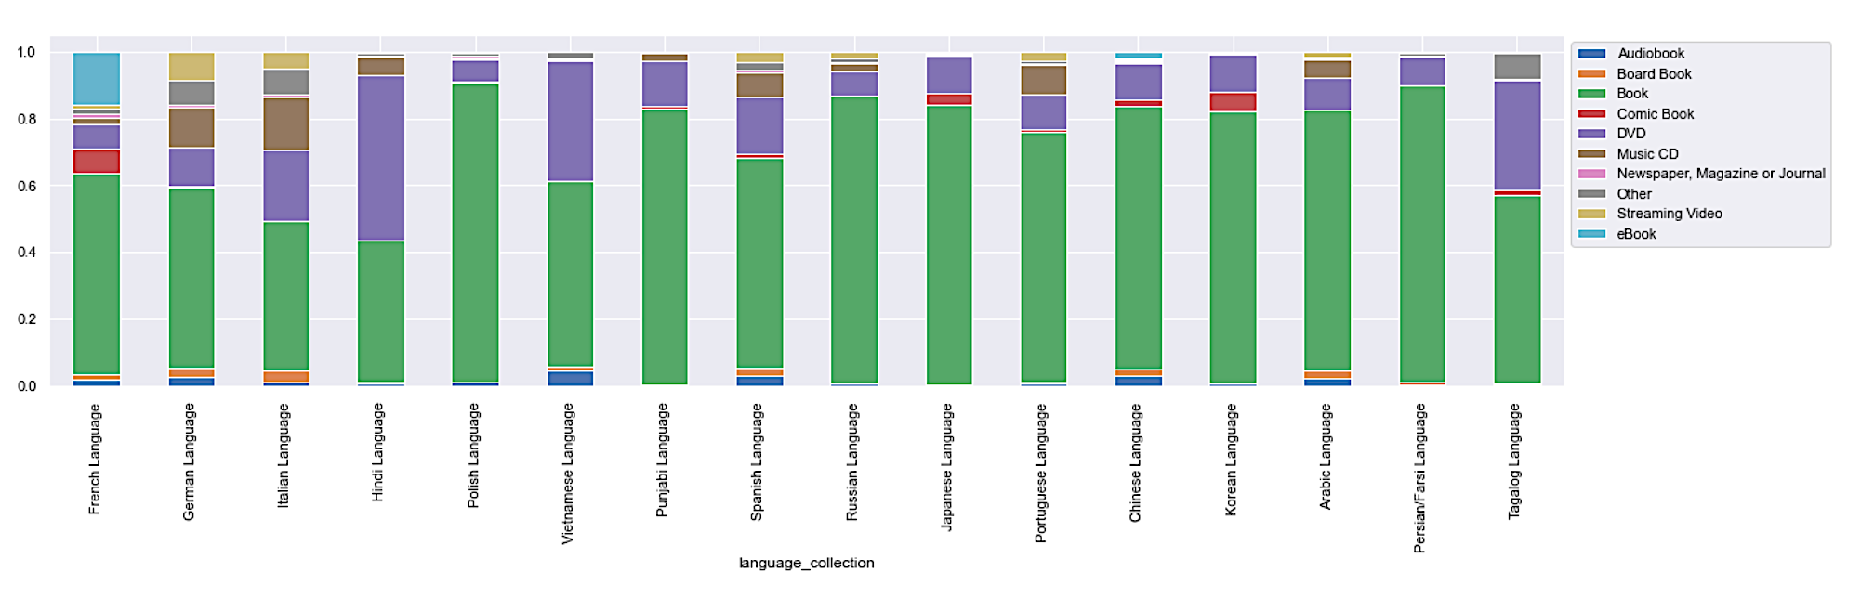
Language Collection : For each language, what is the percentage of material in different categories (Audiobook, DVD, Books etc.…)?
~60% of material in Hindi language is DVDs. Italian, Vietnamese, & Tagalog languages have ~20%, ~40% and ~30% of their material as DVDs
Italian and German languages have ~10% of the material as Music CDs and ~5% of the material as streaming video
French has ~20% of the material available as eBooks, more so than any other languages
Korean (~5% of material), French & Japanese languages have more comic books than other languages

Slide 9
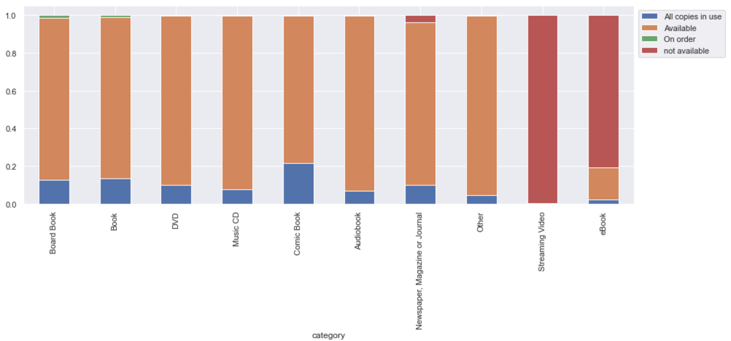
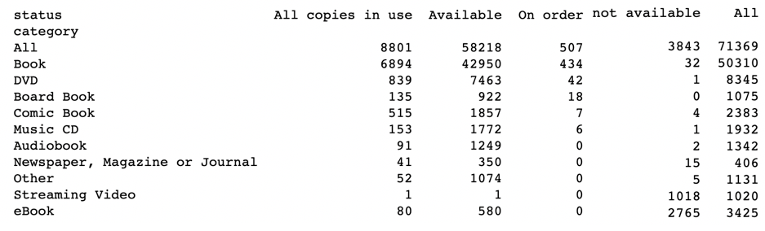
Analyzing the availability status & category of all materials
No status information is available for a major percentage of Streaming video & eBooks and small percentage of newspaper, journals
Out of 8801 materials with all copies in use, 6894 are books (78%), 839 are DVDs (9.5%), 515 are comic books (5%), 135 are board books (1.5%), 153 are music CDs, 91 audiobooks, & 80 eBooks...

Slide 10
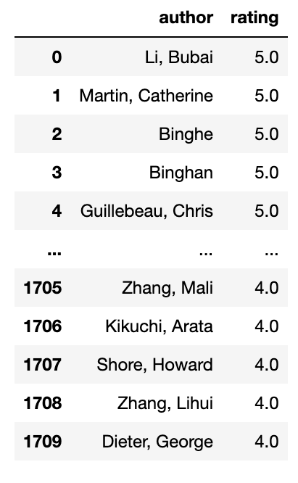
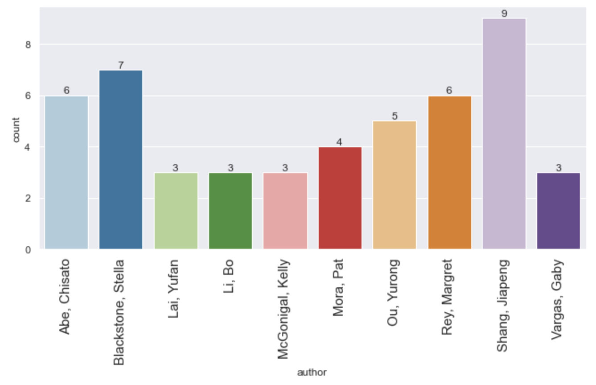
Let’s visualize top 10 authors who have an average rating of 4 or higher across all their published materials
& the most number of published materials at VPL
List of author’s with avg. rating 4 or higher across all their material at VPL
Top 10 author’s in
terms of count of material at VPL
& countless other visualizations possible…

Slide 11
Summary
The languages carried by a VPL branch provides an insight into the international demographic of that particular region!
All locations carried Chinese language material, & all but 1 carried French language. This was followed by 7 locations carrying Spanish & 4 locations carrying Vietnamese language material
Across all VPL locations & online, maximum material is available in French & Chinese languages (19K+), followed by Japanese & Korean languages (5K+), and then Spanish language. Tagalog, Hindi & Punjabi languages have some of the lowest number of material available
Analysing top author's by most material at VPL, we discovered an author Higashino, Keigo leading, across several Asian languages. Further analysis was performed to see how his work is rated by users/readers across languages
Language vs category analysis revealed the following:
~60% of material in Hindi language is DVDs
~10% of material in Italian & German languages is Music CD, & ~5% is DVDs
~20% of material in French language is eBooks, more so than any other languages
Korean, French & Japanese languages have a higher percentage of material as comic books than other languages
Similarly, availability status vs category information revealed that a major percentage of streaming video & eBooks, and a minor percentage of newspapers & journals do not have any availability information available. In terms of material with status "All copies in use", majority are books (78%), followed by DVDs(9.5%) and then comic books (5%)
Author's were further categorized by popularity (i.e., user rating) & number of published material at VPL

Slide 12
Challenges & Next Steps
Because of the nature of the website & type of information, all of the data collected was categorical & not numerical in nature. As a result not much scope for feature engineering
The data collected has limited analysis & inference scope as it pertains to only those records available on VPL website. More data needs to be collected on popular international authors & merged with the data collected at VPL to see whether VPL carries popular material or not
User information is not private, so unable to determine what the user preference is. Having this information can enable interesting predictions on what material is more popular & in demand for library to plan it's stocking & sourcing accordingly

